Slide 1
OCTO-DE Impact Review:
10-10CG MuleSoft Integration
10-10 Health Apps team
Heather Justice - 10-10 Health Apps team, Product Manager
01/06/2023

Slide 2
Problem
10-10CG MuleSoft Integration Impact Review, 01/06/2023
What Veteran-oriented problems did you attempt to solve?
Salesforce latency caused timeouts and form submission failures, which prompted the Veteran to fill out the form online again or print it to submit via mail or in-person
How does solving this problem contribute to OCTO-DE’s Objectives ?
By implementing the Vets-API retry functionality, along with Mulesoft queuing capability, we are able to:
Increase the quality and reliability of VA services, by reducing timeouts and submission failures
Increase the percentage of applications submitted online, by implementing retries and queuing and removing the burden of failures from applicants
Decrease the time from benefit discovery to delivery, by combining data in a single API call that will transmit faster and more reliably
Why is solving this problem a priority vs. other problems?
Since the 10-10CG form is not an authenticated form, it does not save in-progress as someone fills it out. Therefore, any timeouts or submission failures resulted in having to either filling out the form online again and try resubmitting, or print out the form to submit. This is a significant source of frustration and application abandonment by Veterans and their caregivers.
When Salesforce wants to make updates, it is restricted due to the connectivity to VA.gov and any changes have a potential to break that connection, causing additional submission failures.

Slide 3
Problem
10-10CG MuleSoft Integration Impact Review, 01/06/2023
What organizational challenges did you pursue?
Since Vets-API connected directly to Salesforce/CARMA, adding in a middleware is a significant change for both the 10-10 team as well as our Mulesoft and Salesforce teams.
Phase 1 coordination was focused on integration only, which allowed our teams to learn and understand more about how each system works, and how they will best work together.
Phase 2 coordination was focused on adding the layers of fail-safe retries and queuing capabilities, which provided our teams more insight into how failures are handled before and after submissions from VA.gov and how it will remove duplicative efforts from Veterans and Caregivers.

Slide 4
Hypotheses, Solutions
10-10CG MuleSoft Integration Impact Review, 01/06/2023
Hypotheses
Solving for the Salesforce latency would reduce the number of resubmissions, as well as frustration and abandonment by Veterans and their caregivers.
Implementing the Mulesoft middleware layer will allow Salesforce API changes to be managed without impact to VA.gov/Vets-API
Implementing the Vets-API retry capability will add another layer of protection against application submission failures
Solution(s)
The solution was to place the Mulesoft Proxy in between VA.gov and Salesforce so that Mulesoft could:
Manage API updates between itself and Salesforce, taking the burden off VA.gov/Vets-API
Receive single, asynchronous requests for each application to queue and provide a faster response to the VA.gov frontend
The additional solution was to implement the Vets-API retry capability so that VA.gov could:
Mitigate latency or connectivity issues between itself and Mulesoft
Mitigate failures that occur prior to the Mulesoft call, such as MPI outages
Display a single message thanking the applicant for submitting the form and the next steps (receiving a confirmation email, a phone number to call if they don't get the email, timeframe for processing)
All without interrupting or impacting the VA.gov experience

Slide 5
Results
10-10CG MuleSoft Integration Impact Review, 01/06/2023
Launch date: Phase 1 → 3/30/2022
Impact on Users, Business, and/or Technology
Quantitative
The monthly average number of API errors after Phase 1 (introduction of Mulesoft middleware) has reduced by 28%
The monthly average number of successful submissions has increased to over 1,000 applications per month
Qualitative
Even before the queuing capability was implemented, the Mulesoft middleware was already displaying more reliability in managing the volume of applications being submitted.
Launch date: Phase 2 → 9/23/2022
Impact on Users, Business, and/or Technology
Quantitative
The monthly average of API errors after Phase 2 (implementation of Vets-API retries and Mulesoft queue) has reduced to miniscule numbers (5 or less over last 3 months)!
There have been 121 applications retried by Vets-API and successfully submitted
Most retries have been due to several MPI and other system outages
Qualitative
While we may still experience other API outages, we are still able to retry the existing application until it can be submitted successfully.
This greatly reduces the duplicative efforts for the Veteran and Caregivers

Slide 6
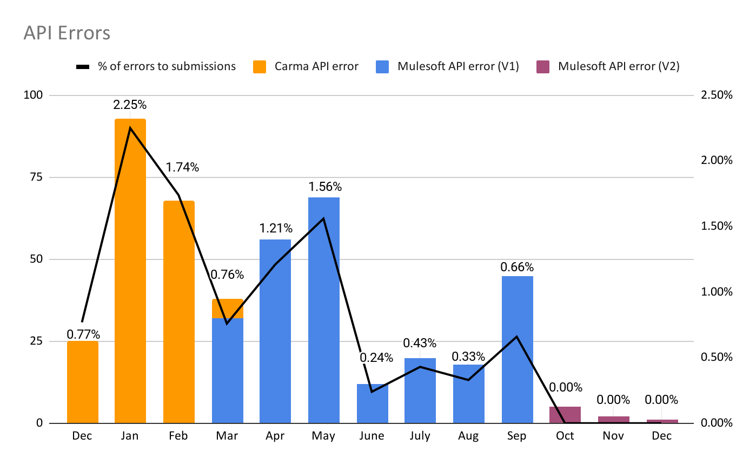
History of API errors
10-10CG MuleSoft Integration Impact Review, 01/06/2023
Prior to Phase 1 of Mulesoft implementation
CARMA API averaged 58 errors per month
Phase 1 of Mulesoft implementation (3/2022)
Mulesoft API averaged 36 errors per month
Phase 2 of Mulesoft and Vets-API implementation (9/2022)
Mulesoft API has had a total of 8 errors in 3 months
Vets-API Retries averaged 40 applications retried successfully per month
Notes:
While the percentage of errors were fairly low, it was not getting any better. The stakeholders wanted to find a way to make it more reliable for the Veterans, and also more efficient for the business.

Slide 7
Team
10-10CG MuleSoft Integration Impact Review, 01/06/2023
Heather Justice, Product Manager
Mark Fallows, Associate Product Manager
Lihan Li, Backend Engineer
Lisa Zapson, Frontend Engineer
Matt Long, Frontend Engineer
Nick Osmanski, Designer
Jessica Stump, Design and research
Past Team Members
Kevin Musiorski, Backend Engineer
James Childers, Sr. Engineer
Dene Gabaldon, Design and research
Mickin Sahni, Sr. Principal Product Manager
Sharon Kasimow, Product Manager

Slide 8
Open Discussion
10-10CG MuleSoft Integration Impact Review, 01/06/2023
Recommendations
Continue to monitor retries from Vets-API, watch for issues stemming from Mulesoft and/or Salesforce
Watch for issues stemming from other dependent services, such as MPI, EVSS, etv
Notes
…

Slide 9
10-10CG MuleSoft Integration Impact Review, 01/06/2023
Executive Summary
Problem and why it was important to solve problem
Salesforce latency caused timeouts and form submission failures, which prompted the Veteran to fill out the form online again or print it to submit via mail or in-person. Since the 10-10CG form is not an authenticated form, it does not save in-progress as someone fills it out. This is a significant source of frustration and application abandonment by Veterans and their caregivers.
When Salesforce wants to make updates, it is restricted due to the connectivity to VA.gov and any changes have a potential to break that connection, causing additional submission failures.
Hypotheses
Solving for the Salesforce latency would reduce the number of resubmissions, as well as frustration and abandonment by Veterans and their caregivers.
Quantitative Results
Phase 1: The monthly average number of API errors has reduced by 28% (from avg 58 CARMA API errors to 36 Mulesoft errors per month)
Phase 2: Mulesoft API had a total of 8 errors in 3 months, all submissions retried successfully
Vets-API Retries averaged 40 applications retried successfully per month
Recommendations
Continue to monitor retries from Vets-API, watch for issues stemming from Mulesoft and/or Salesforce
Watch for issues stemming from other dependent services, such as MPI, EVSS, etv

Slide 10
Start here
<Initiative> Impact Review, DD/MM/YY
Please maintain the slide style, fonts, and formatting when crafting your deck.
Fill in your name, team and date in Slide 1’s footer.
Every slide after Slide 1 needs a title and the <Initiative> Impact Review, DD/MM/YY header.
Answer bolded questions.
Consider (and then delete) italicized questions.
Charts, graphs, and images need captions, titles and axis labels.
Add a thin border to any visuals and make sure it fits on the slide entirely (see Slide 4 for an example).
Executive Summary slide can be populated in advance but plan to complete it immediately following the presentation, adding any pearls from the discussion.
Remove any blank slides.

